Slide 1
Albemarle County Special Education Parent Advisory Committee
(SEAC)
Presentation to the
Albemarle County School Board
December 12, 2024

Slide 2
Our Mission
“Advise the local school division of needs in the education of children with disabilities”;
“Participate in the development of priorities and strategies for meeting the identified needs of children with disabilities”;
“Submit periodic reports and recommendations regarding the education of children with disabilities … to the local school board”;
“Review the policies and procedures for the provision of special education and related services prior to submission to the local school board”; and
“Participate in the review of the local school division's annual plan.”
8 Virginia Administrative Code 20-81-230(D)

Slide 3
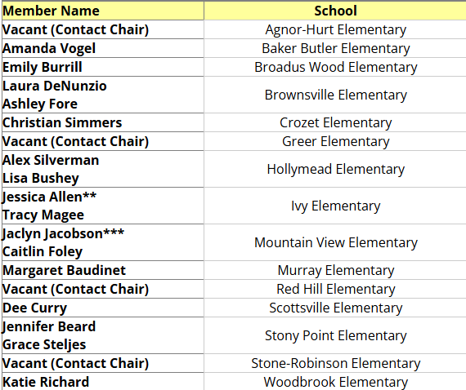
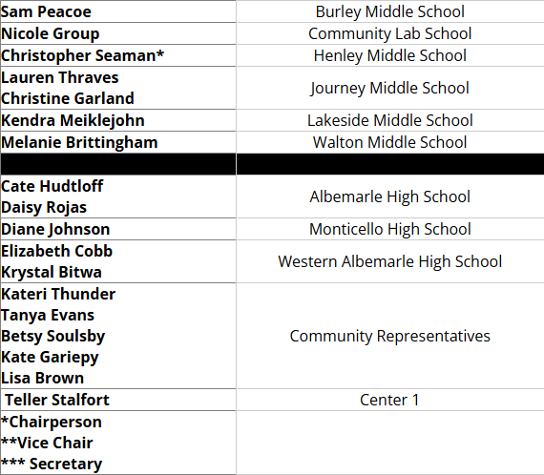
2024-25 SEAC Membership

Slide 4
Data Sources
SEAC Family Survey (2024)
Family Council Family Survey (2024)
Virginia Standards of Learning (SOL) Assessments (2021-24)
2024 State of the Division Report
Other sources as indicated

Slide 5
SEAC Family Survey (2024)
Open to all families with a child receiving special education services from ACPS
Distributed & administered in October 2024
  Email and text messages by ACPS
  Flyers, social media & school officials by SEAC
363 responses
  33% increase over last year
  20% response rate (1804 students w/disabilities)

Slide 6
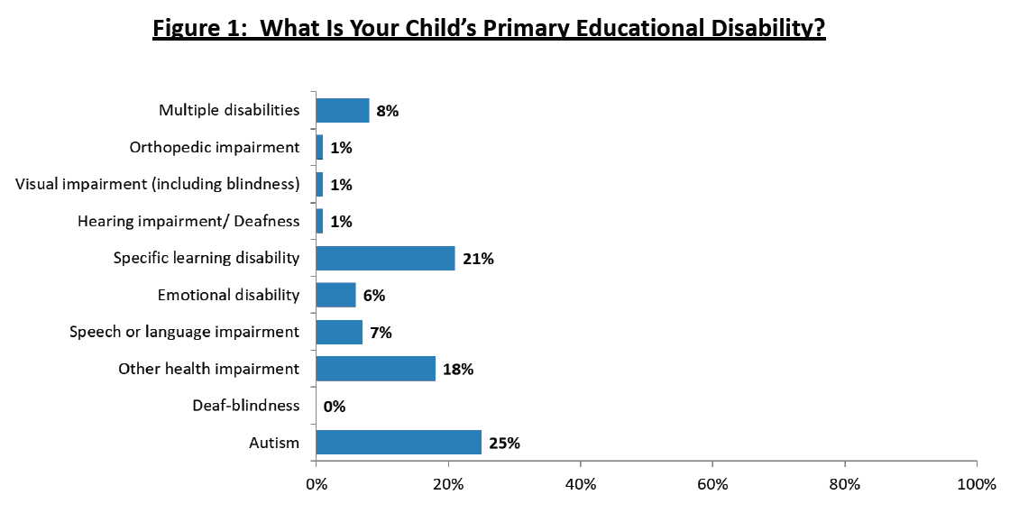
SEAC Family Survey (2024)

Slide 7
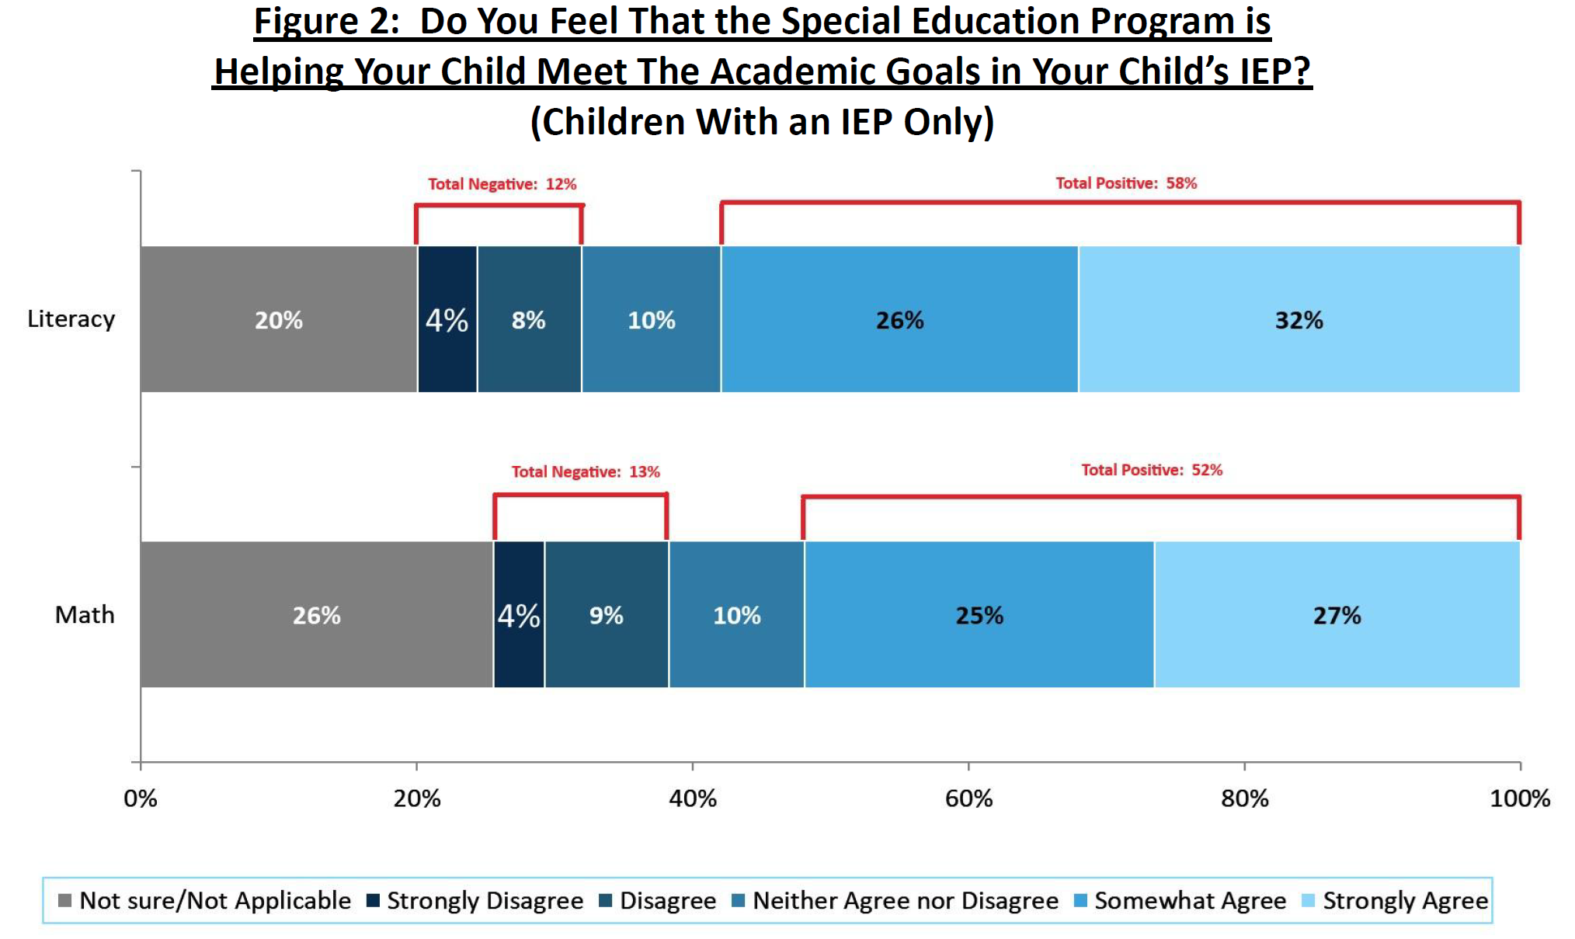
SEAC Family Survey (2024)

Slide 8
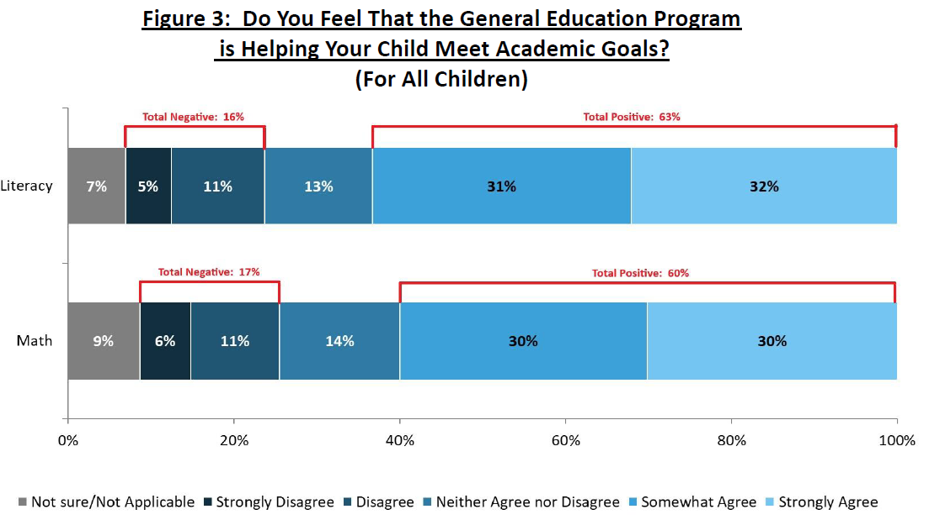
SEAC Family Survey (2024)

Slide 9
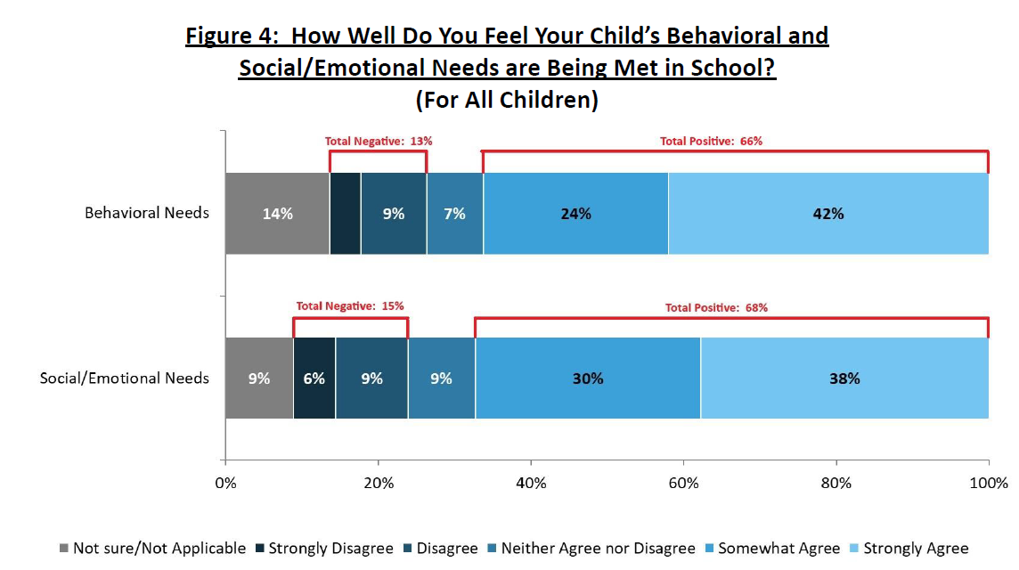
SEAC Family Survey (2024)

Slide 10
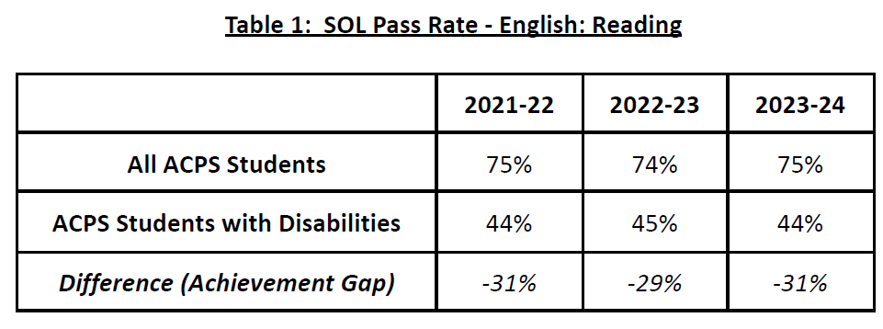
SOL Results

Slide 11
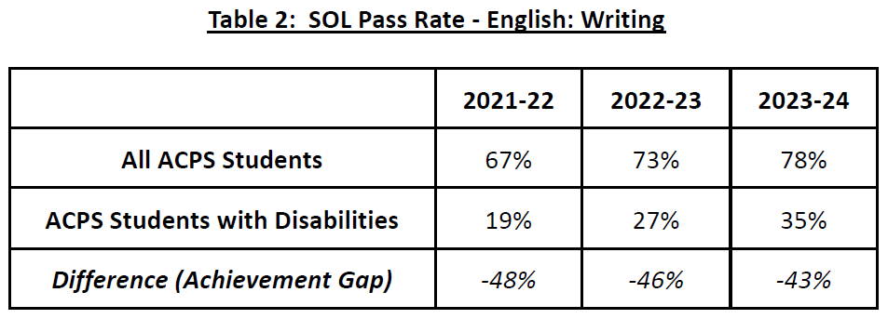
SOL Results

Slide 12
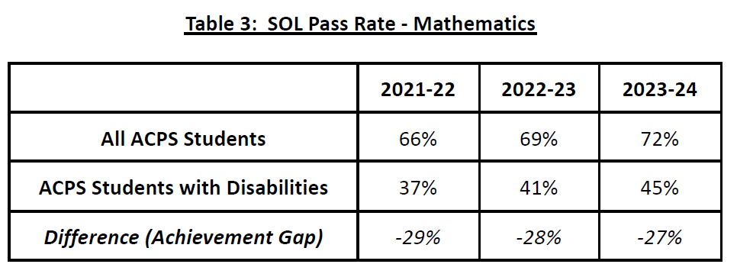
SOL Results

Slide 13
Recommendations
Increase Support for Meaningful Inclusion
Add a position for a learning specialist
Add a position for a behavioral specialist
  Both specialists would serve as coach to general and special education teachers regarding accommodations for academics and behavior.

Slide 14
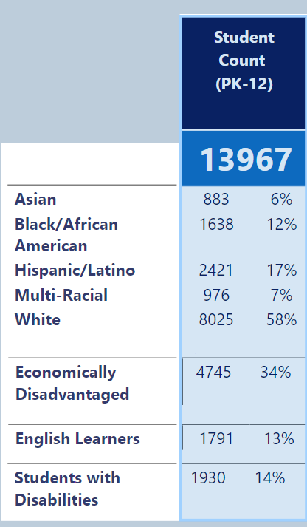
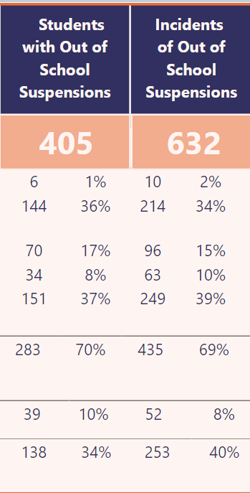
Disproportionality in School Discipline

Slide 15
Disproportionality in School Discipline
Source: 2024 State of the Division Report

Slide 16
Recommendations
Increase Support and Retention for Special Education Teaching Assistants (TAs)
Include TAs in Professional Learning Community time
Include TAs in shared planning time w/teachers
Increase paid professional development days for TAs
Analyze compensation rate for TAs

Slide 17
Special Education TA Pay
Currently $17.50/hour to $21.25/hour
Annual salary: $24,018 to $29,165
  For 7.5 hours/day, 183 work days
Living Wage for Albemarle County (MIT):
  $25.20/hour for 1 adult, no children
  $29.64/hour for 2 adults (both working), 2 children

Slide 18
Special Education TA Retention Rate (Nov. 2023 – Nov. 2024)
Source: 11/27/24 email from Dan Redding, Executive Director of Human Resources

Slide 19
Recommendations
Special Education Services for
Specialized Schools
Evaluate whether additional special education teachers and/or TAs are needed at Center I
  Currently 1 teacher, no TAs for up to 250 students
Evaluate whether needs of Post High students are being met
  Based on comments in family surveys

Slide 20
Recommendations
Increased Support for Math Education
  Large and persistent achievement gap in math SOL pass rates for students with disabilities
  Survey respondents noted struggles of children with disabilities in math
  Some survey respondents hired private math tutors at their own expense

Slide 21
Recommendations
Accessibility Issues
Conduct accessibility and inclusion audit for all school buildings and school grounds
  Include professionals, community members, and students
  Share results of audit with SEAC and public
  Use results to inform building repairs and upgrade plans
Conduct audit related to ability of students, teachers, and staff with disabilities to safely evaluate all school facilities

Slide 22
Thank You!

